Slide 1
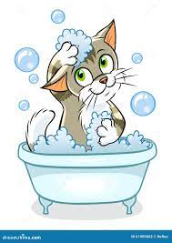


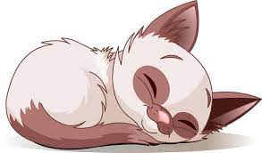
A Dog’s Life
Proposal for a website

Slide 2
Home page
Grooming Services
Map to store
Contact information
How to select a Good pet

Slide 3
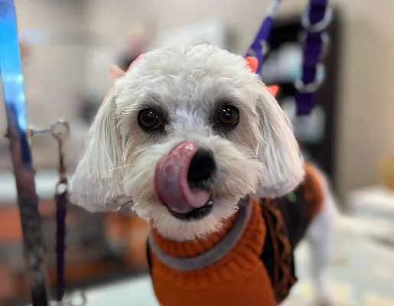
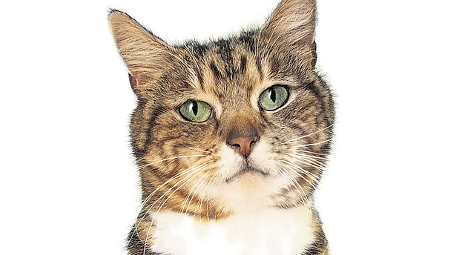
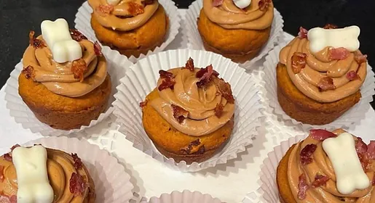


WE treat your fur babies like our own. Love and care with every wash and every cut!
Today’s Special’s

Slide 4
asdfasdf

